Slide 1
Retrieval Practice: Ground Rules
Notes:
Educator – Please set ground rules to ensure that the classroom is a safe space.
Student agency at the beginning of teaching CSE lessons is key to them adhering to these rules
At the beginning of every lesson, remind the class of these rules.

Slide 2
My Values My beliefs
Lesson Objective: Discover what values and beliefs you have that influence how you view the world and how you behave.

Slide 3
What fuels your motivations and drives your attitudes and behavior?
“You’d like to think it’s all a conscious decision and the result of in-depth rationalization on your part. There’s truth to that, but there are many other levers inside of you that act subconsciously. Among those, two fundamental concepts live at the root of everything. If you understand what these are, you can not only understand yourself and what is holding you back in life but even scratch the surface of understanding the world and its behavior, at least since the rise of consciousness. So, what drives our attitude and behavior at the most basic level? It’s our beliefs and values”.
Notes:
Source: https://iulianionescu.com/blog/how-our-beliefs-and-values-shape-our-behavior/

Slide 4
Definitions
Values – The principles of qualities that a person considers important in their life,
Belief – are ideas, convictions or opinions individuals hold about themselves, others and the world.

Slide 5
Belief
Beliefs are the things we hold true, regardless of whether we have any proof of their objective truth. Beliefs are developed and inherited. As we grow up, we learn and take on the views of those around us, especially those whom we look up to. Parents, teachers, mentors, colleagues—they all pass their beliefs on to us, and we have the leeway to accept them or not. In time, we might turn them into our own beliefs or reject them.
We also develop beliefs resulting from personal experiences and the feelings that we associate with them in those moments. More so, we develop beliefs through our repeated actions. If you are consistently late, you start to believe that you are terrible at time management when, in fact, a better alarm clock and sleep habits could change that label. In time, beliefs shape our identity, and we become them to some extent.
Some examples of beliefs that you might recognize are: God has created the world; if a black cat crosses in front of you, something horrific will happen; man has evolved from primates. As you may notice, some of these beliefs have science behind them, while others clearly do not. Scientific research has constantly changed people’s opinions over time by providing proof to the contrary. Think about ideas such as the Earth being flat and the Sun revolving around the Earth. At some point, people believed that. Later on, science proved that they were not true, and (most people) stopped believing them.
Regardless of the level of scientific or empirical proof, most people have difficulty justifying their beliefs, and frankly, most of us don’t even like to. As a matter of fact, we all would be a lot happier if everyone else around us had the same beliefs as we do, but arguably this would be boring. Of course, that is impossible, and this is precisely what fuels most of the world’s conflicts
Notes:
Teacher – read as a class or as an individual. Clarify any words that students do not understand.

Slide 6
There are three main types of beliefs that we all have…
Belief’s about ourselves.
Beliefs about others
Beliefs about the world we live in.
Activity: Split the class into 3 groups.
1. One person in the group is to read the information about the belief to the group.
2. Then, individually each students writes 3 beliefs they have.. For example, those that read about beliefs in ourselves would write 3 beliefs they have about themselves. E.g. ‘I believe I am good at sports’.
3. Students in their groups, then share their beliefs.
Look for similarities/differences.
Students are to ask each other to explain why they hold these beliefs. Remember, be respectful, it is natural to all hold different beliefs.
Notes:
Teacher – you could also split the class into 6 groups, 2 of each belief and run this activity in 2 pods if you feel smaller groups would be better.
The 3 beliefs information are at the end of the PPT these can be printed or put into a shared online space.

Slide 7
Reflection
Did you find any common beliefs within your group?
How do they compare to your own beliefs?
Were there any beliefs that surprised you or challenged your thinking?
How might our beliefs shape our attitudes and behaviors towards others?
Notes:
This could be individual thinking time, class or written exercise. Do what is best for you class.

Slide 8
If beliefs are things that we believe to be true, values are the compass in life that tell us what is right and what is wrong. Our values are often derived from our beliefs, but not always. Values set our standard for what we would and would not be prepared to do. In other words, what we think is important. However, note that values do not drive our actions; they simply tell us what the right and wrong things to do. are.
Activity: Choose 5 words that you feel are important to you.
Notes:
Educator – display the words for students to choose. They can do this silently/quietly, as after there will be some discussion questions.

Slide 9
Discussion Questions
What values did you choose?
Why are these values important to you?
Are there any values on the display that surprised you or you didn't consider before?
How might your values influence your behavior and decision-making?
Notes:
Educator – this lesson could be done as a whole class, in small groups or as a personal reflection. Wander around and listen if you choose the group option, you may find some interesting points of view to share.

Slide 10
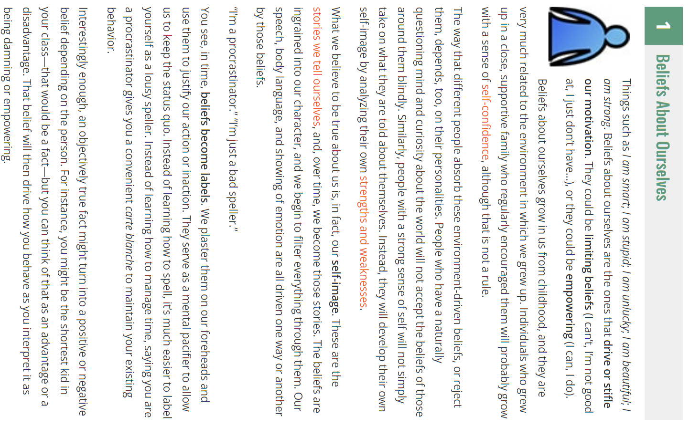

Slide 11
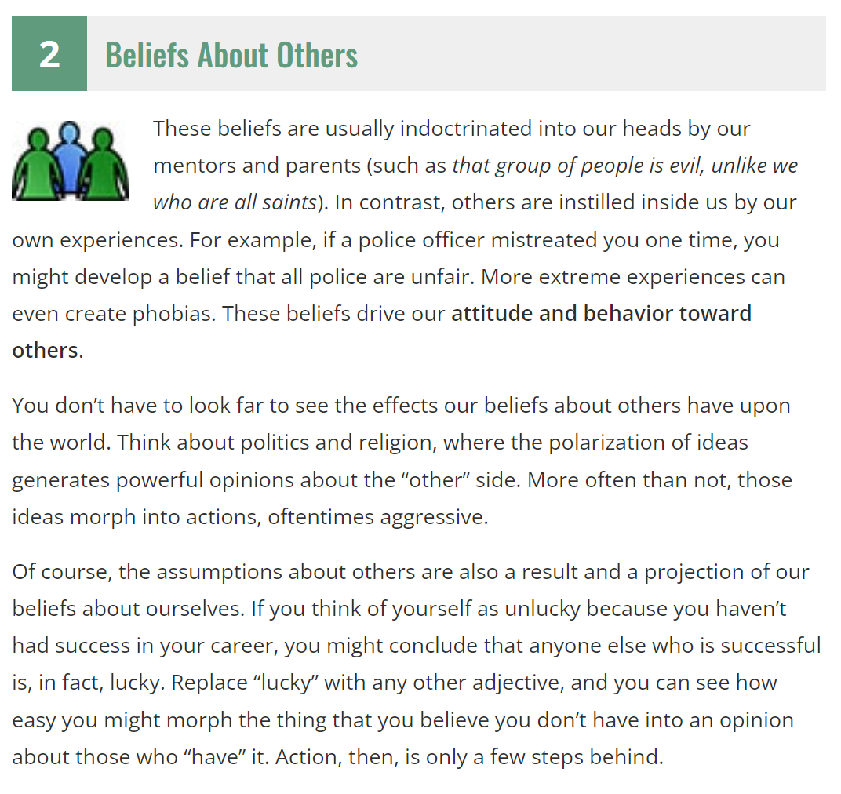

Slide 12
