Slide 1
Love…from the heart or the brain? Discuss
Notes:
NB; allow students to share their ideas in small groups and then as a class. Allow students to agree/disagree with each other’s comments and why. You do not need to provide any answers as this is the basis of the lesson

Slide 2
Lesson objective: Demonstrate proficiency in describing the chemical components associated with the emotions of lust, attachment and attraction UN Technical Guidance Key Concept 1.2 Friendship, Love and Romantic Relationship 5.3 Communication, Refusal and Negotiation Skills 7.2 Sexual Behaviour and Sexual Response

Slide 3
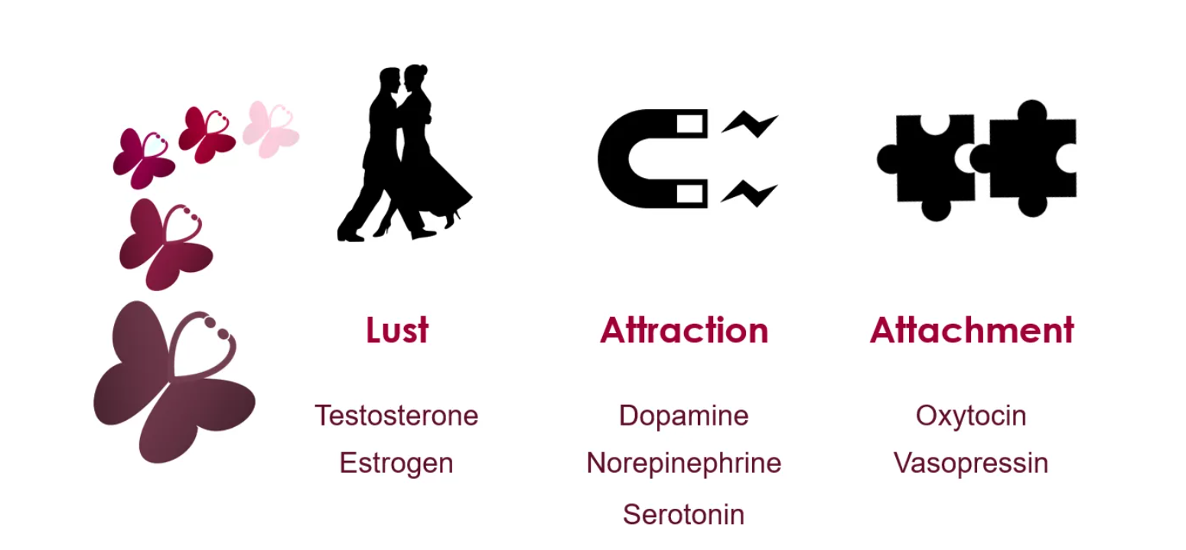
The science behind love…
“According to a team of scientists led by Dr. Helen Fisher at Rutgers, romantic love can be broken down into three categories: lust, attraction, and attachment. Each category is characterized by its own set of hormones stemming from the brain (Katherine Wu, 2017)”
Tito Adhikary
Notes:
Source: https://sitn.hms.harvard.edu/flash/2017/love-actually-science-behind-lust-attraction-companionship/

Slide 4
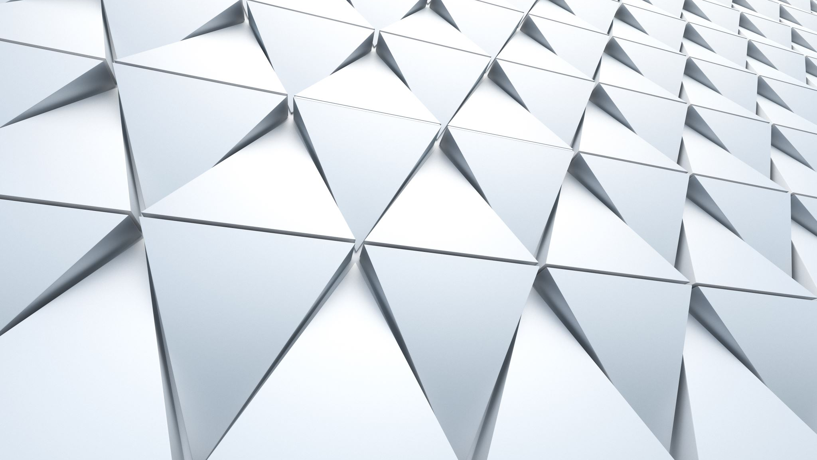
Understanding the chemicals responsible for our (sometimes) poor decision making when it comes to love
The end product of today’s lesson is to create a museum of love. The aim is we can walk around the museum and understand the chemicals and the reactions they are responsible for.
There will be 7 groups, each group will be responsible for a different hormone.
The museum will be set up in three sections of lust, attraction and attachment. You will therefore need to collaborate with the other groups in your section (see previous slide).

Slide 5
What should you make?
Your product should be fun and informative!
Some ideas could include……
3D model with labels and explanations using playdoh/lego/online platform
A short movie that can be played on an IPAD/Laptop as we walk around the museum
A rap/song/poem
Notes:
NB; depending how your class is structured, you may want to allow students one or two lessons to create their product, using another to do the walk through the museum followed by the discussion questions at the end. You may also wish to display these around your institution.

Slide 6
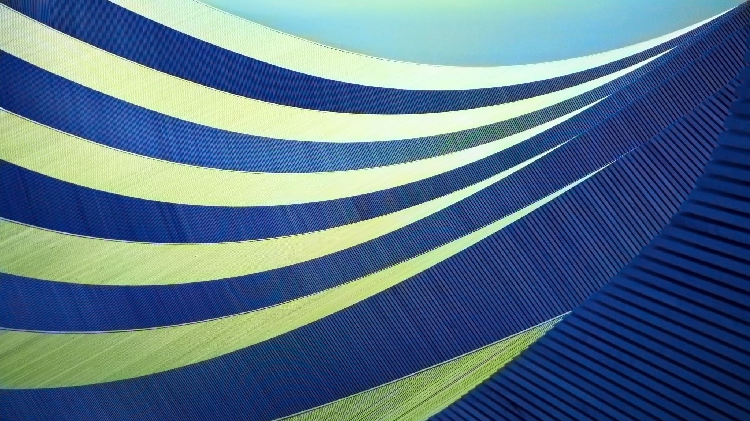
Where should I get my information?
This article is well written and factual, you should all be able to access the information and use it to create your museum piece.
Only AFTER you have read this article and if you need to, can you support it with other evidence.
https://sitn.hms.harvard.edu/flash/2017/love-actually-science-behind-lust-attraction-companionship/

Slide 7
What should I include in my museum piece?
Name of the chemical
Where it is released/found in the body
It’s role in either lust, attraction or attachment
What is a healthy response to the chemical
What happens if you have too much of this chemical

Slide 8
Reflection/discussion questions
How has this changed your thinking with regards romantic attraction?
Can you always trust your feelings?
Notes:
It would be great if you brought the class together for a discussion about these questions, alternatively, they could do this in small groups.

